Slide 1
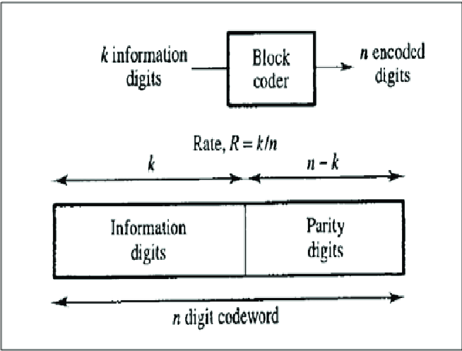
LINEAR CODES - BLOCK CODES AND CONVOLUTIONAL CODES
In coding theory, a linear code is an error-correcting code for which any linear combination of codewords is also a codeword.
In this form, the code word consists of (n-k) parity check bits followed by k bits of the message. The structure of the code is as shown:

Slide 2
LINEAR BLOCK CODES
User inputs:
k → Message length,
n → Code word length,
P → Parity matrix or coefficient matrix [size is (n-k)-by-k ].
I → Identity matrix
G = [P I_{𝑘} ] → Generator Matrix
∴ G = [ P eye(k,k) ] gives the Generator Matrix
The parity check matrix H is given as:
H = [I_{n-k} P^{T}]
∴ H =[ eye(n-k,n-k ) P’ ] gives the Parity check matrix

Slide 3
GENERATION OF CODEWORDS FROM MESSAGE BITS
All_M is all the combinations of message sequences depending upon the length of the message defined by user.
Code Word Matrix = [message *Generator Matrix] = [m mP]
∴CodeWordMat= All_M * G
CodewordMat= modulo (C ,2) calculates Code word Matrix
Note: modulo() is used to for modulo 2 operations of binary bits

Slide 4
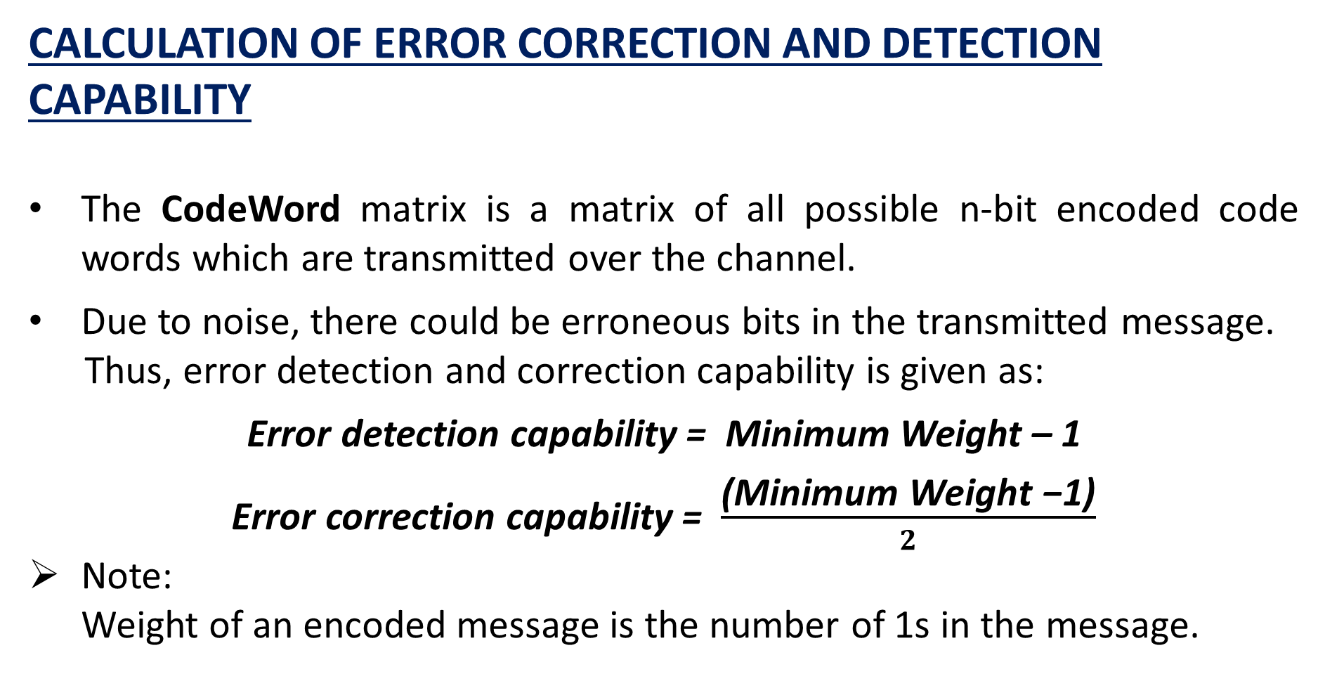
CALCULATION OF ERROR CORRECTION AND DETECTION CAPABILITY
The CodeWord matrix is a matrix of all possible n-bit encoded code words which are transmitted over the channel.
Due to noise, there could be erroneous bits in the transmitted message.
Thus, error detection and correction capability is given as:
Error detection capability = Minimum Weight – 1
Error correction capability = $\frac{\text{(}\text{Minimum} \text{Weight}\text{ −1)}}{2}$
Note:
Weight of an encoded message is the number of 1s in the message.

Slide 5
SYNDROME CALCULATION
When there is an error, the decoding operation will give a syndrome vector, whose elements contain at least one non-zero element.
Syn → Syndrome
Syndrome (S) = Y*H^{T}
∴ Syn= Y *(H’)
Syn=modulo(Syn,2) calculates the Syndrome

Slide 6
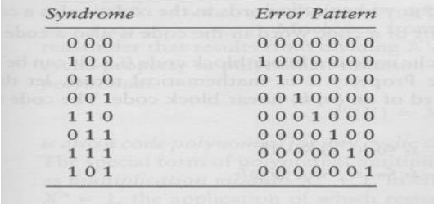
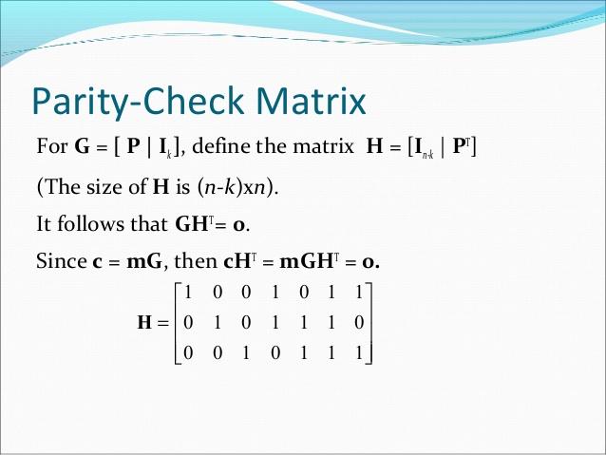
Error Pattern is an error vector E whose non-zero elements mark the position of the transmission errors in the received codeword.
All the syndromes can be worked out by column wise transposing the Parity check matrix H. Thus, we can find the corresponding error patterns for decoding purposes.
Example: For a (7,4) Linear Block Code the error pattern, Syndrome and Parity check matrix is given below:

Slide 7
ERROR DETECTION
Y denotes the 1-by-n received vector that results from sending the code vector CodeWord over a noisy channel.
The code word corresponding to the entered message string is extracted from the CodeWordMat using:
z=bin2dec(M)+1 → M is the entered message string CodeWord=CodeWordMat(z,:)
Using rand() function we generate a random number from 1-n
This is the position of error in the transmitted message sequence
Y=CodeWord is the transmitted erroneous encoded message

Slide 8
ERROR CORRECTION AND DECODING
ErrPattern →Error Pattern Matrix
ErrPos → Position of error in the sequence
We initialise ErrPattern to a zero vector of size 1-by-n and ErrPos to 1
Using a while loop we compare the Syndrome to d where d=[H(:,ErrPos)]’. On every iteration we increment ErrPos by 1
If d is equal to the Syndrome we break the loop and update ErrPattern as:
ErrPattern(ErrPos)=1
Corrected Code word = Received erroneous Code word + Error Pattern
∴ CorrectedCodeWord= [CodeWord + ErrPattern] gives the
corrected code word

Slide 9
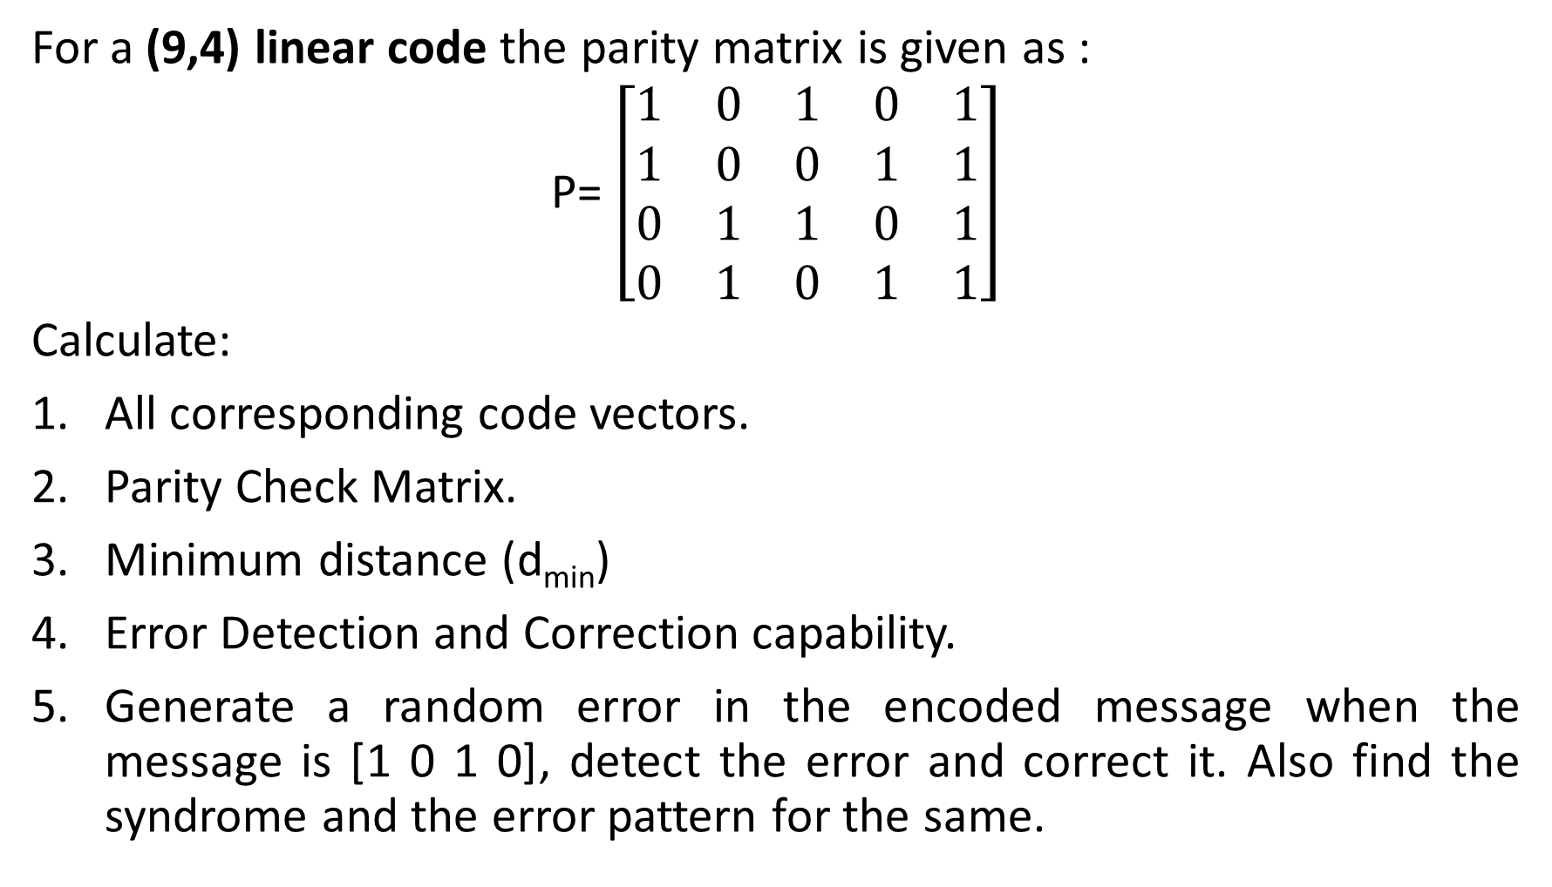
Example 1: (9,4)
For a (9,4) linear code the parity matrix is given as :
P= $\left[\begin{matrix}1 & 0 & 1 & 0 & 1 \\ 1 & 0 & 0 & 1 & 1 \\ 0 & 1 & 1 & 0 & 1 \\ 0 & 1 & 0 & 1 & 1\end{matrix}\right]$
Calculate:
All corresponding code vectors.
Parity Check Matrix.
Minimum distance (d_{min})
Error Detection and Correction capability.
Generate a random error in the encoded message when the message is [1 0 1 0], detect the error and correct it. Also find the syndrome and the error pattern for the same.

Slide 10
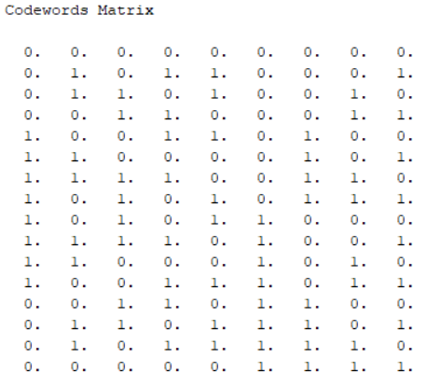
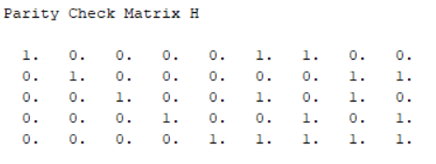
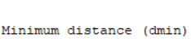

Answer 1 (Scilab Output)
1.Code vectors | 2. Parity Check Matrix | 3. Minimum distance d_{min}

Slide 11
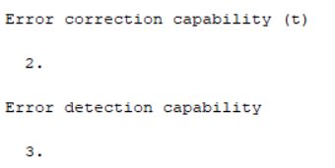
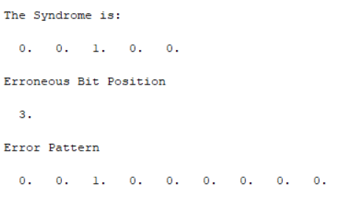

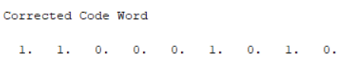
4. Error Correction and Detection capability | 5.A Syndrome and Error pattern | 5.B Erroneous and Corrected message

Slide 12
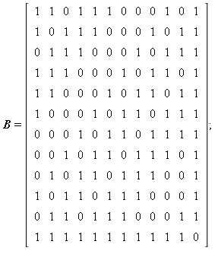
Example 2: Extended Golay Codes
For the (24,12) that is extended Golay Code find the minimum distance (d_{min}). The parity matrix is given as:
P

Slide 13

ANSWER 2 (SCILAB OUPUT)
The minimum distance (d_{min}) is:
This proves the properties of extended Golay Code:
The weight of every codeword in G₂₄ is a multiple of 4.
The code G₂₄ has no codeword of weight 4, so the minimum distance of G₂₄ is d = 8.

Slide 14
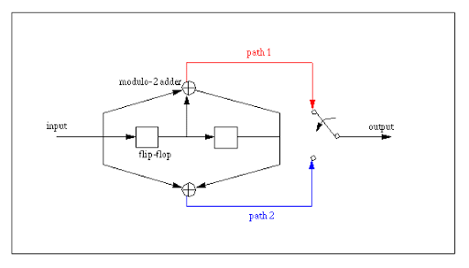
LINEAR CONVOLUTIONAL CODES
In telecommunication, a convolutional code is a type of error-correcting code that generates parity symbols via the sliding application of a boolean polynomial function to a data stream.
CONVOLUTIONAL ENCODER

Slide 15


GENERATION OF PARITY BITS BY TIME DOMAIN APPROACH :
User Input:
g1 → top-adder sequence (no bits restriction )
g2 → bottom –adder sequence
m → message sequence
In the time domain approach, the output by convolution is given as:
Top output sequence = X_{i}¹ =
Bottom output sequence = X_{i}² =
$$\sum_{l=0}^{m}{g1l mi−l}$$
$$\sum_{l=0}^{m}{g2l mi−l}$$

Slide 16
In each iteration of while loop, we extract n-bits from the message sequence where n is the length of the adder sequence.
We element wise multiply top/bottom adder sequence with these n-bits and store the convoluted output in a matrix.
We iterate the while loop till we exhaust the message bits.
Thus, while (i ~= (length(m1)-k+2))
tempmat=m1((i:i+l-1))
temp=modulo((g1*tempmat'),2)
x1=[x1 temp]
i=i+1
end
gives the parity bits from the top adder. Similarly, we get parity bit from the bottom adder.

Slide 17
CHECK:
Scilab has the function convol() which can be used to check our output.
Thus, g1=flipdim(g1,2)
g2=flipdim(g2,2)
x1 = round(convol(g1,m))
x2 = round(convol(g2,m))
x1 = modulo(x1,2)
x2 = modulo(x2,2)
should give the same output.
Note:
In convol(), indexing is from left to right hence flipdim() must be used to flip g1 and g2.

Slide 18
EXAMPLE:
Find the output parity bits from a Convolutional Encoder where:
Top adder sequence = [1 0 1 1]
Bottom adder sequence =[ 1 0 0 1]
Message sequence = [1 0 1 1 1 0 1 1 0 1]
Also find the total number of parity bits.

Slide 19
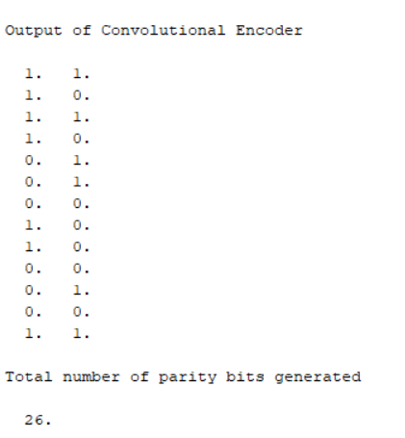
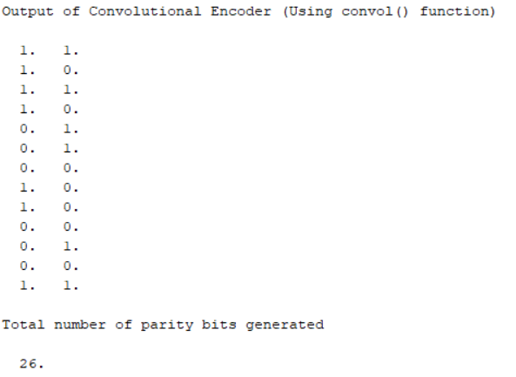
ANSWER (SCILAB OUPUT)
Using loops : | Using Scilab built-in function:

